Slide 1
Project Management - Initiation
Rui M. Lima and André Luiz Aquere
(School of Engineering of University of Minho)
Notes:
This are the slides for the first class related to general concepts of project management: initiation

Slide 2
Project and Project Management
Project
A temporary effort made to create a unique product, service or result. (PMBOK, 2004).
A unique process, composed of a group of coordinated and controlled activities with start and end dates, carried out to achieve a goal according to specific requirements, including cost, time and resource limitations. (IPMA, 1999)
An exclusive set of coordinated activities, with a defined beginning and end, carried out by an individual or an organization, to achieve specific objectives, with a determined schedule, cost and performance. (SABATO, 1975)
Project Management
“Application of knowledge, skills, tools and techniques to project management activities in order to satisfy it requirements.”

Slide 3
Project - Operations
Project | Operations
Temporary | Continuous
Unique result | Repeated results
Structure is not predefined | Predefined structure
Project and Operations
Transform inputs into products
Carry out a series of coordinated and controlled activities
Have restrictions on cost, time and resources
Are subject to performance and quality criteria

Slide 4
Project - Programs - Portfolios
Strategy
PORTFOLIO
PROGRAM A
PROGRAM B
PROJECT B
PROJECT D
PROJECT A
PROJECT E
PROJECT F
PROJECT C
Resources

Slide 5
Project Management
Project management is the application of knowledge, skills, tools and techniques to project management activities in order to satisfy it requirements.”
QUESTIONS TO ANSWER
What will I produce?
What are the customer's needs and expectations?
Who will do the job?
How long will it take?
How much will it cost?
What can go wrong?
How to avoid potential problems?
TIME
SCOPE
QUALITY
COST

Slide 6
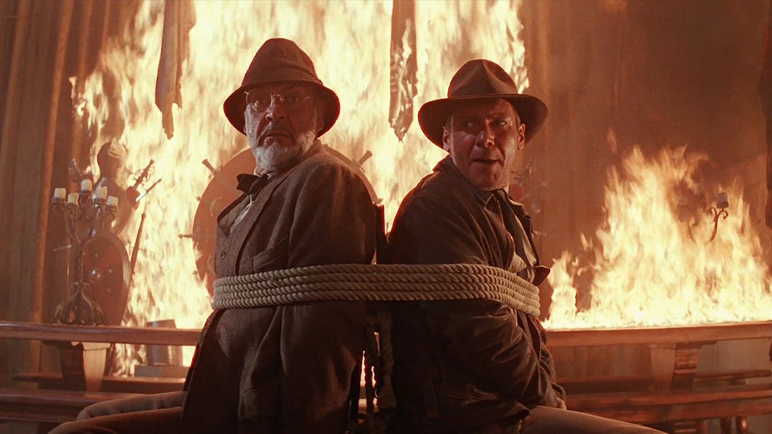
Why Project Management?
What do we do now?
I'm planning!!!
Source: Indiana Jones

Slide 7
PM characterization
High
Influences of Interested Parties
COST OF CHANGES
Low
Project Time
Source: PMI 6th Edition

Slide 8
Project Management Methodologies
CORE
SCRUM
DevOps
Agile
...
Sprint
By competencies (IPMA)
By Processes (PMI)
Predictive Iterative Incremental Agile
(Ways of approaching the Project Life Cycle)

Slide 9
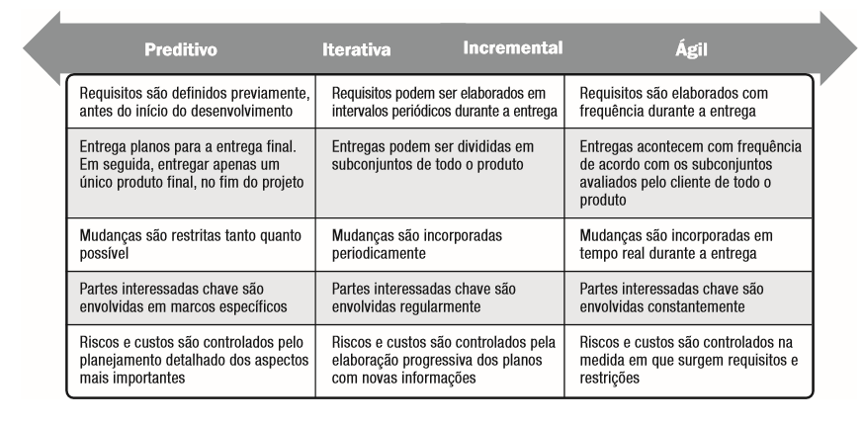
Project Management Methodologies
. Predictive Iterative Incremental Agile .
Requirements are defined in advance, before the start of development
Requirements can be established at periodic intervals during delivery
Requirements are developed frequently during delivery
Delivery plans for final delivery. Then, deliver only a single final product at the end of the project
Deliveries can be divided into subsets of the entire product
Delivery occurs frequently according to the subsets evaluated by the customer for the entire product
Changes are restricted as much as possible
Changes are incorporated periodically
Changes are incorporated in real time during delivery
Key stakeholders are involved in specific milestones
The main stakeholders are regularly involved
Key stakeholders are constantly involved
Risks and costs are controlled by detailed planning of the most important aspects
Risks and costs are controlled by the progressive elaboration of plans with new information
Risks and costs are controlled as requirements and restrictions arise
Source: PMI 6th Edition

Slide 10
Project Management Methodologies
There are several management frameworks (set of knowledge, skills, tools and techniques) that help us answer the previous questions.
However, everyone seeks to meet the following characteristics:
Collaborative
Has open architecture
Results oriented
Easy to apply

Slide 11
Project Management Environment
Environment
Society
Organization
Project

Slide 12
Project Management Institute (PMI)
PMI – Project Management Institute
  Sets standards - process-centered
  PMBoK Guide; Reference Guides; Articles; Periodicals
  Promotes publications, research; congresses ...
  Certifies professionals,...
  Created in 1969
  Present in more than 190 countries
  Has about 500,000 members
  Project Management Processes
  (PMI Knowledge Areas)

Slide 13
Project Management Body Knowledge (PMBOK)
Identifies a subset of management knowledge that is widely recognized as good practice.
PMI considers PMBOK® a basic project management reference for its professional development programs and certifications.
PMBOK® is not a methodology and is not complete or comprehensive. It is necessary to look for sources of additional information on project management.
The application of knowledge, processes, skills, tools and appropriate techniques significantly impact the success of a project.

Slide 14
PMBOK - Processes and Knowledge Areas
 | Project Management Process Groups
Processes and Knowledge Areas | Initiation (2) | Planning (24) | Execution (10) | Monitoring and control (12) | Closing (1)
Integration (7) | Develop the Term of Opening | Develop Management Plan | Direct and Manage project work Manage project knowledge | Monitor and control the project work; Perform integrated change control | Finalize the project or phase
Scope (6) |  | Scope management planning; Collect requirements; Scope definition; Create WBS |  | Check scope; Track scope
Schedule (6) |  | Schedule management planning; Define activities; Activity sequencing; Estimate activity resources; Estimate the duration of activities; Develop schedule |  | Timeline control
Cost (4) |  | Cost Management Planning; Estimate Costs; Determine budget |  | Cost Control
Quality (3) |  | Quality Management Planning | Execution of quality assurance | Quality control
Resources (6) |  | Resource Planning Estimate Activity Resources | Acquire resources Develop the project team; Manage the project team | Resource management control
Communication (3) |  | Communication Management Planning | Manage communication | Monitor communications
Risk (7) |  | Risk Management Planning; Identify the risks; Perform qualitative risk analysis; Risk response plan. | Implement risk responses | Monitor risks
Acquisitions (3) |  | Purchasing management planning | Make acquisitions | Control of acquisitions
Stakekholders (4) | Identify Stakeholders | Stakeholder engagement planning | Manage stakeholder engagement | Monitor stakeholder engagement
Project and Operations
Transform inputs into products
Carry out a series of coordinated and controlled activities
Have restrictions on cost, time and resources
Are subject to performance and quality criteria

Slide 15
PMBOK - Knowledge Areas
SCOPE
SCHEDULE
COST
INTEGRATION
QUALITY
TIME
SCOPE
PROJECT
QUALITY
RESOURCES
RISK
COST
COMUNICATION
ACQUISITIONS
STAKEHOLDERS

Slide 16
PMBOK - Process Groups
Initiation
Planning
Execution
Closing
Monitoring
and Control
Design Phase
Organization and Preparation
Execution of Works
EFFORT
Project Conclusion Phase
TIME

Slide 17
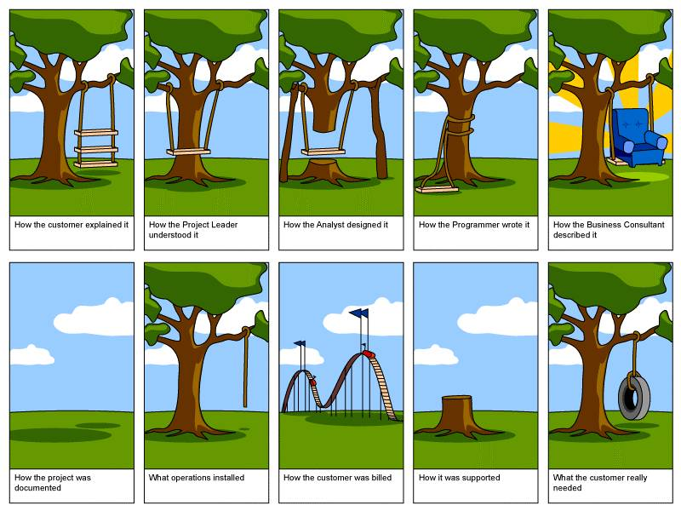
Start a Project (Project Chart)
Align expectations

Slide 18
How a project is born?
BUSINESS
PROJECT
CONTRACT
PROPOSAL
Project charter
Project charter
Approved
PROBLEM
[TIME]
PROJECT
[COST
PRODUCT
ORDER
{GOAL}
DOD
CLIENTE
SPONSOR
PROJECT MANAGER

Slide 19
Initiation Processes
Identify Stakeholders
Develop the Project Charter of the Project
Inputs
Tools & Techniques
Outputs
Inputs
Tools & Techniques
Outputs
1. Project charter
2. Business documents
Business case
Benefit management plan
3. Project management plan
Communications management plan
Stakeholder engagement plan
4. Project documents
Record of changes
Record of issues
Requirements documentation
5. Agreements
6. Company environmental factors
7. Organizational process assets
1. Expert opinion
2. Data collection
Questionnaire and surveys
Brainstorming
3. Data analysis
Stakeholder analysis
Document analysis
4. Data representation
Representation/mapping of interested parties
5. Meetings
1. Register of
Interested Parties
2. Change Request
3. Update of the Project Management Plan
Requirements Management plan
Communications Management Plan
Risk Management Plan
Stakeholder Engagement Plan
4. Updating Project Documents
Registration of Premises
Record of Issues
Risk Register
1.Business documents
Business case
Benefit management plan
2. Agreements
3. Environmental factors of the company
4. Organizational process assets
1. Expert opinion
2. Data collection
Brainstorming
Discussion groups
Interviews
3. Personal and team skills
Conflict management
Facilitation
Meeting managements
4. Meetings
1. Project Charter
2. Registration of Premises
Figure 4-2. Develop the Project Charter: Inputs, Tools and Techniques, and Output
Figure 13.2 Identify the Stakeholders: Input, Tools and Techniques, and Outputs
Source: PMI 6th Edition

Slide 20
Project Charter - Project Chart
Questions
    What is expected to be produced?
    By whom?
    How long?
    For how much?

Slide 21
Estimates - Time and Cost
Estimates and Accuracy Levels
Analog
Parametric Deterministic
Bottom – Up
Three points Probabilistic (Risks)
-50%
+100%
Accuracy
Information
-5%
+10%

Slide 22
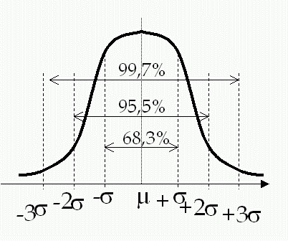
Three Point Estimate
Beta Distribution (PERT)
Average = O +4*ML + P Variance = [(P-O) / 6]²
6
Standard deviation = (P-O) / 6
  O = Optimistic estimate
  ML = Most Likely estimate
  P = Pessimistic estimate
  1 σ = 68,3%
  2 σ = 95,5%
  3 σ = 99,7%

