Slide 1
Introduction to the Fourth Industrial Revolution
Rui M. Lima, Cristiano Jesus
(School of Engineering of University of Minho)
Notes:
This slides give a general overview about I4.0, preparing students to initiate the project related to I4.0. Remember that the project can be linked to other courses and in that case aligned with those courses. If it is not linked with other courses, than this will prepare them to initiate the project related to I4.0 maturity models

Slide 2
What does the concept of Industry 4.0 best represent for you in practical terms?
Automatization
Technology
Internet of things
Globalization
Big data
Simulation
Digital transformation

Slide 3
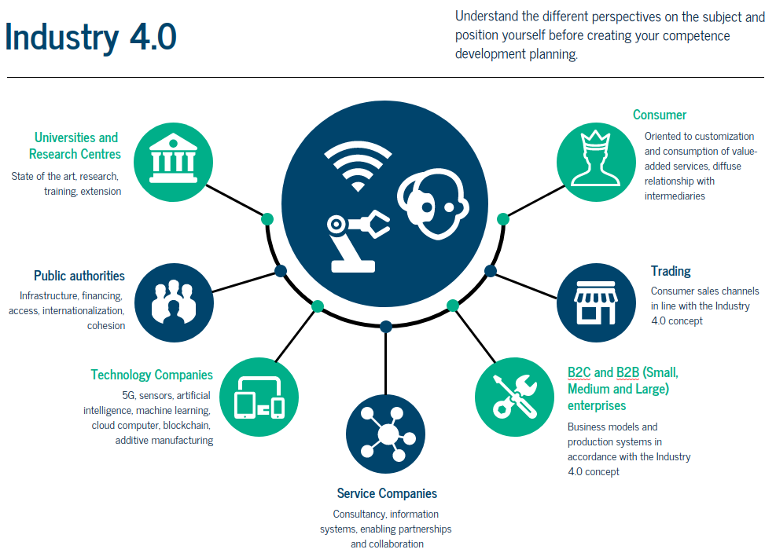

Slide 4
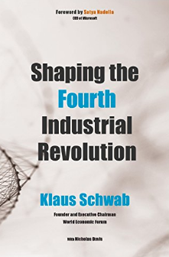
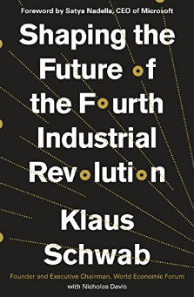
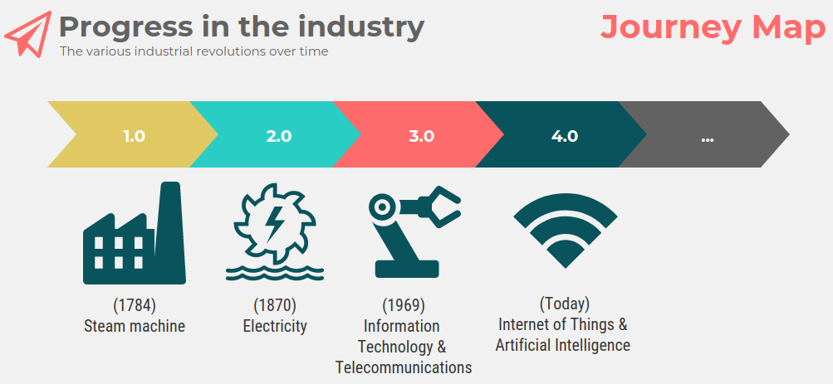
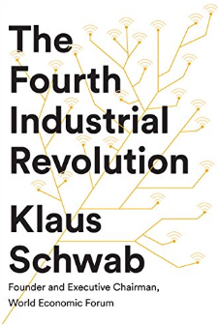
History – Industrial Revolution (IR)

Slide 5
Industry 4.0
Germany – Industry 4.0
Portugal – Portugal i4.0
USA – Manufacturing Renaissance
Netherlands – Smart Industry
United Kingdom – High Value Manufacturing
France – Industrie du Futur
Spain – Fabricacion Avanzada
Italy – Fabbrica Intelligente
Belgium – Made Difference
Switzerland – Industrie 2025
Austria – Produktion der Zukunft
Greece – Operational Programme
Sweden – Produktion 2030
Finland – Industrial Internet Business Revolution
Poland – Digital Manufacturing for SME
India – Smart Manufacturing
Singapore – Precision Manufacturing
China – Made in China 2025
Japan – Innovation 25’ Program

Slide 6
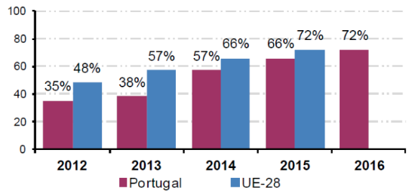
Assumptions and principles
Proportion of people aged 16-74 using the Internet in portable devices, Portugal and EU-28, 2012-2016
National Institute of Statistics, Portugal
By 2030, a large part of the global population will have a mobile phone;
Transition from product to service
Netflix, Spotify, Uber, Airbnb, etc.
Transition from security in the profitability of assets through scale production to variety at the level of product configuration.

Slide 7
Business model
The ultimate goal is to become an agile company, capable of continuous and agile adaptation to a changing environment.
Environment
People
(Organizational
Culture)
Organization
(Business Process)
System
The company as
a complex system
Technology
(Resources)
Source: Laudon, Kenneth C.; Laudon, Jane P. (2019).
Information Systems. Pearson.

Slide 8
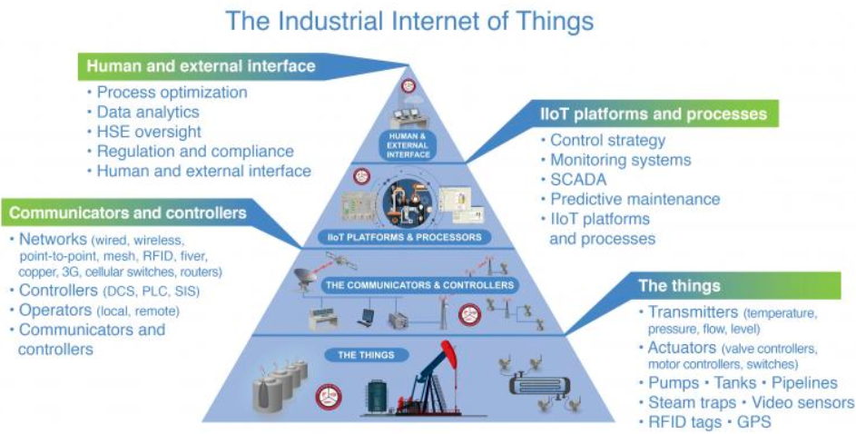
Industrial Internet of Things (IIot)
Source: Control Global

Slide 9
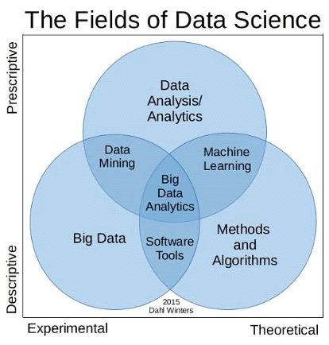
Data Science (Artificial Inteligence, Machine Learning, Big Data Analysis)
Deep
Learning
Source: Understanding Different Components & Roles in
Data Science (Divya Singh)

Slide 10
Cloud Computing
Credit: Network Encyclopedia

Slide 11
Blockchain
Credit: Alina Grubnyak on Unsplash, World Forum Economic

Slide 12
Prototype and simulation
Tecnomatix - Siemens

Slide 13
Augmented Reality
Credit: Adobe Stock

Slide 14
3D Printer (additive manufacturing)
Credit: A Voz da Indústria
Credit: Manufatura em Foco

Slide 15
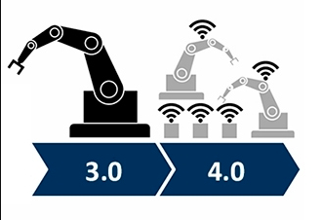
Autonomous systems

Slide 16
Reconfiguration plans reviewed
Readiness assessments are evaluation and analysis tools that aim to determine the level of preparedness of an organization in terms of conditions, attitudes and resources.
Frameworks are collections of procedures, methods and tools focused on the design of an organizational architecture or a system.
Roadmaps are "plans that match short-term and long-term goals with specific technology solutions to help to meet those goals".
Maturity models are models that help organizations achieve expected skills in specific dimensions such as culture, processes, resources, etc., through continuous improvement processes.

Slide 17
New Competences
Credit: REUTERS/Issei Kato, World Economic Forum

Slide 18
Sustainability
Source: Bakkari, M., & Khatory, A. (2017). Industry 4.0:
Strategy for More Sustainable Industrial Development
in SMEs. Proceedings of the IEOM 7th International
Conference on Industrial Engineering and
Operations Management, (Rabat, Morocco), 11–13.
Social
Bearable
Equitable
Sustainable
Environment
Economic
Viable

Slide 19
Industry 4.0 Attributes
Interoperability or the ability to achieve results by different means, to perform the same functions, despite possible exchange of equipment and manufacturers.
Decentralization, which corresponds to the ability to make decisions without dependence on a data processing center or a decision-making body of human resources.
Virtualization, reproduction resource or simulation of the real world in virtual mode.
Modularity, capacity for change, to make processes more comfortable and adherent depending on environmental configurations and the need for variations in product design.
Real-time reaction through analysis of large volumes of data that allow the identification of profiles and even subtle changes in scenarios.
Orientation to services made possible by the integration of processes, since they present themselves as adequate means to mediate the relationship of the consumer market with the companies, as an opportunity for improvements in the final use of the product.

Slide 20
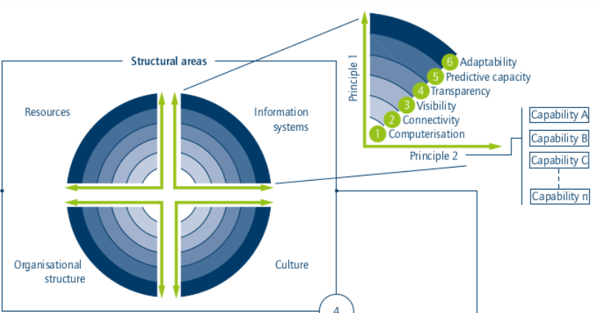
Maturity index (Acatech)

Slide 21
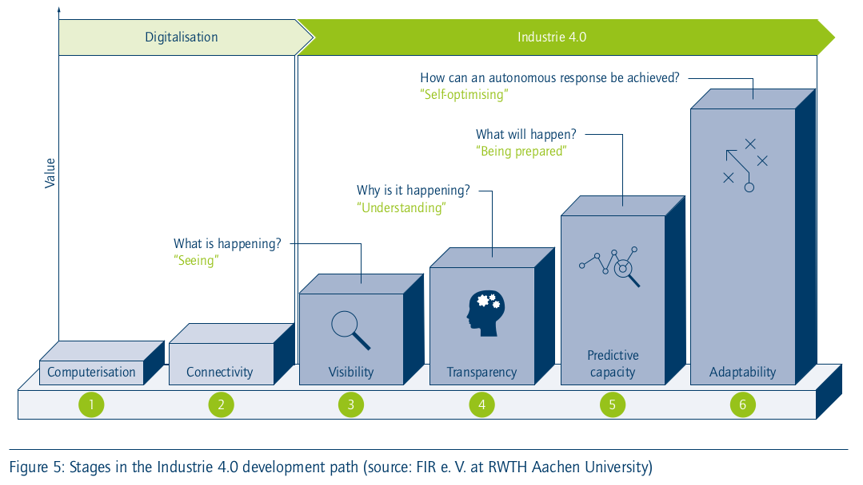
Maturity levels (Acatech)

Slide 22
Maturity levels (Acatech)
Computerization - use of information technology;
Connectivity - integration of IT tools;
Visibility - sensors allow processes to be monitored from end to end;
Transparency - digital shadow indicates the current situation;
Predictive capacity - ability to simulate scenarios;
Adaptability - ability to adapt continuously.

Slide 23
Resources
Digital capability - (1) digital skills (human resources), (2) automated data acquisition through sensors and actuators, (3) decentralized pre-processing of data collected in an automated way.
Structured communication - (1) efficient communication, (2) design of (3) task-based interfaces.

Slide 24
Information Systems
Information processing - (1) data analysis, (2) contextualised data delivery, (3) application-specific user interfaces, (4) resilient IT infrastructure.
Integration - (1) horizontal and vertical integration, (2) governance, (3) data interface standards, (4) security.

Slide 25
Organizational Structure
Internal organization - (1) flexible communities, (2) decision rights management, (3) motivational goal systems, (4) agile management.
Dynamic collaboration and value networking - (1) focus on customer benefits, (2) network cooperation.

Slide 26
Culture
Social collaboration - (1) democratic leadership style, (2) open communication, (3) confidentiality process and information systems.
Willingness to change - (1) recognition of the value of errors, (2) openness to innovation, (3) knowledge database and decision-making, (4) continuous professional development, (5) change modelling.

Slide 27
Project
Development of critical knowledge (Acatech model...)
Planning, project management - Canvas, Scrum, etc.
Development of items (questions) by dimensions foreseen in the Acatech model (each team is responsible for one dimension)
Application and validation t-test
Tabulation and diagnosis
Final presentation

Slide 28
Procedure for developing the questionnaire
Identify theoretical milestones (critical knowledge)
The constructs form the items (questions) and the items form the instrument (questionnaire)
Example of construction: Business excellence
It is possible to develop a conceptual description of this expression, however, from this theoretical basis it is necessary to extract variables to measure it, for example, business excellence should be calculated by weighting the following indicators: market leadership (weight 10), growth (25), profitability (30), liquidity (15), indebtedness (10).

Slide 29
Items development
Items should be structured (do not use images, projective techniques or creativity tests)
Take care with divergent interpretations between the author of the test and the subject evaluated (validate by means of the "think aloud" technique)
Ensuring matching one item - one task, and one task - one idea.
Use a likert scale with 4 or 5 posts: I totally disagree, more I disagree than I agree, more I agree than disagree, I totally agree.

Slide 30
Procedure for developing the questionnaire
Application in at least one company (ideally more than one)
Public - directors, managers or supervisors
Acatech model: 4 dimensions with 2 themes in each dimension and 2 to 6 sub-themes in each theme.
Develop from one to two items for each sub-theme so that they total 10 items for each dimension.
The composition of the questionnaire with 40 questions will be carried out by teachers Rui and Cristiano
Each team must apply the full questionnaire.

