Slide 1
Cyber Physical System (CPS)
and Data Security
Module II: Digital Factory Modeling: How to formulate a virtual world
Prof.Dr.Athakorn Kengpol, KMUTNB

Slide 2
Content
2/39
Digital Factory
Learning Outcome
Definition
Evolution
Difference from software and embedded systems
Heterogeneity and modelling, long term goal
Upgradation
Scientific and technical challenges
Challenges for CPS software design
Expectations and design challenges of CPS
Institutional, societal, and other challenges
Application
Security and Privacy Issues in Cyber-Physical Systems
Activities (Lab sheet)
Summary
Learning Outcome

Slide 3
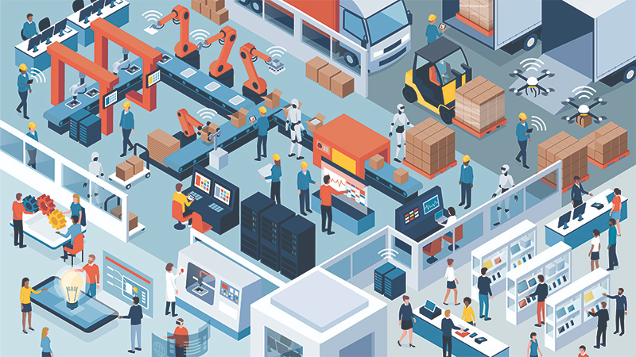
Learning Outcome
3 /39
Digital Factory
Formulate a data model representing data streamlining in a production line of an existing traditional factory using a data flow diagram

Slide 4
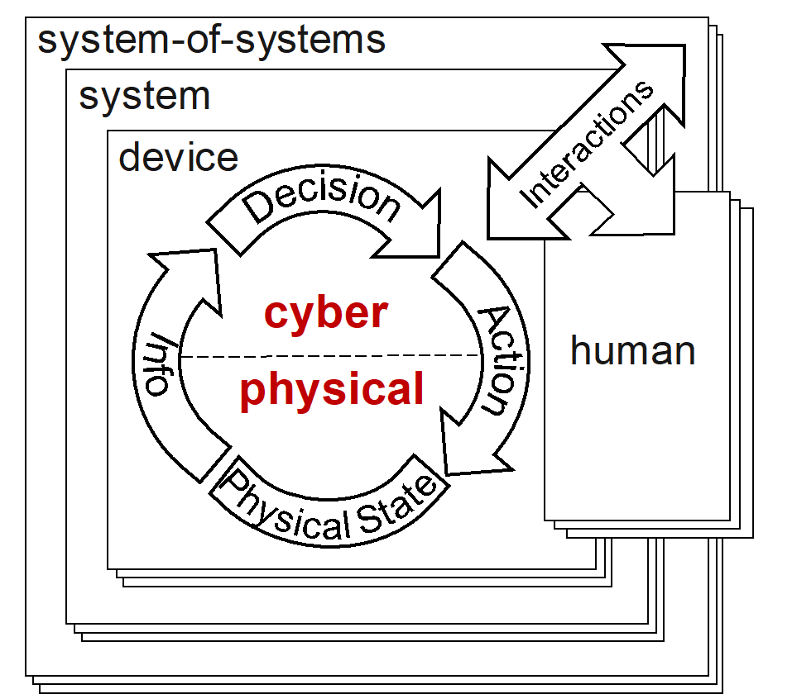
Definition
4 /39
Digital Factory
A cyber physical system (CPS) is a complex system that integrates computation, communication, and physical processes. Digital manufacturing is a method of using computers and related technologies to control an entire production process. Industry 4.0 can make manufacturing more efficient, flexible, and sustainable through communication and intelligence; therefore, it can increase the competitiveness. Key technologies such as the Internet of Things, cloud computing, machine-to-machine (M2M) communications, 3D printing, and Big Data have great impacts on Industry 4.0. Therefore, CPS is the way to streamlining process in a production line of an existing traditional factory using a data flow diagram for Digital factory is important.
Cyber-physical systems are physical, biological, and engineered systems whose operations are integrated, monitored, and/or controlled by a computational core. Components are networked at every scale.
The Framework for Cyber-Physical Systems was released by the NIST CPSPWG on May 26, 2016

Slide 5
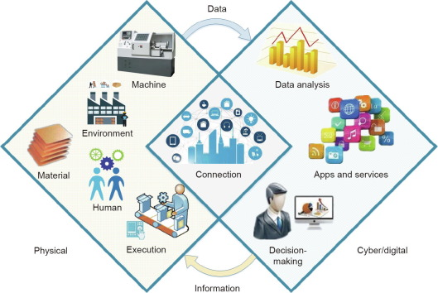
Definition
5 /39
Digital Factory
What are Cyber Physical Systems?
Cyber – computation, communication, and control that are discrete, logical, and switched
Physical – natural and human-made systems governed by the laws of physics and operating in continuous time
Cyber-Physical Systems – systems in which the cyber and physical systems are tightly integrated at all scales and levels Change from cyber merely appliquéd on physical
Change from physical with off-the-shelf commodity “computing as parts” mindset
Change from ad hoc to grounded, assured development
https://www.sciencedirect.com/science/article/pii/S209580991830612X

Slide 6
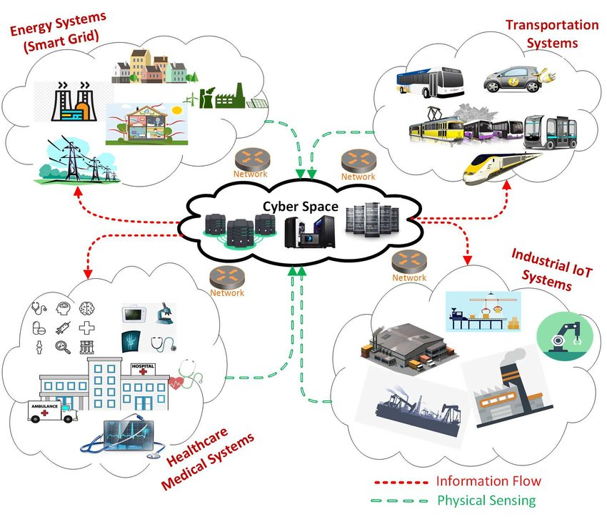
Definition
6 /39
Digital Factory
Why Cyber Physical Systems?
Embedded computers allow us to add capabilities to physical systems.
eg: Computer - controlled automotive engines are fuel-efficient and low-emission.
By merging computing and communication with physical processes, CPS brings many benefits:
Safer and more efficient systems
Reduce the cost of building and operating systems
Could form complex systems that provide new capabilities
Technological and Economic Drivers
The decreasing cost of computation, networking, and sensing provides the economic motivation.
Environmental pressures make new technologies appear to improve energy efficiency and reduce pollution.
https://www.researchgate.net/figure/Application-Scenarios-of-cyber-physical-systems-describing-the-information-flow-and_fig2_329466954

Slide 7
EVOLUTION OF CPS
7 /39
Digital Factory
Two types of computing systems
Desktops, servers, PCs, and notebooks
Embedded
The next frontier
Mainframe computing (60’s-70’s)
Large computers to execute big data processing applications
Desktop computing & Internet (80’s-90’s)
One computer at every desk to do business/personal activities
Embedded computing (21st Century)
“Invisible” part of the environment
Transformation of industry
https://www.slideserve.com/emily-jenkins/ict-1-smart-cyber-physical-s-ystems-in-h2020

Slide 8
EVOLUTION OF CPS
8 /39
Digital Factory
Cyber-Physical systems, a key infrastructure to support smart manufacturing, are integration of physical, networking, and computation processes.
In a physical systems, embedded sensors and other monitoring devices collect DATA to be fed into computation processes in a cyber system. In this system, there is infrastructure constructed digitally to map with the physical one (Digital Twin).
After arrive at an optimal solution, the cyber system will feed information back to control the physical system through actuators.
Networking technology allows the elements in both systems to be connected interactively with each other.

Slide 9
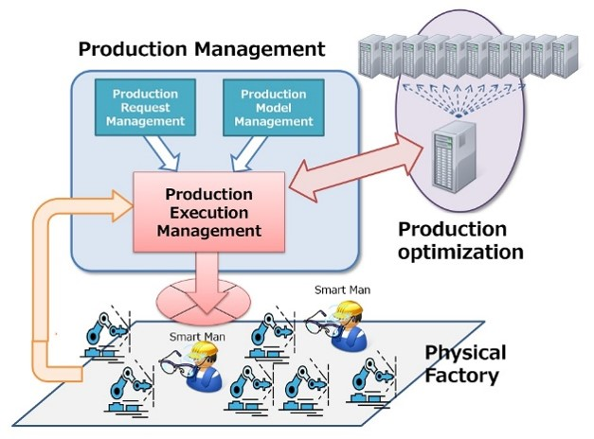
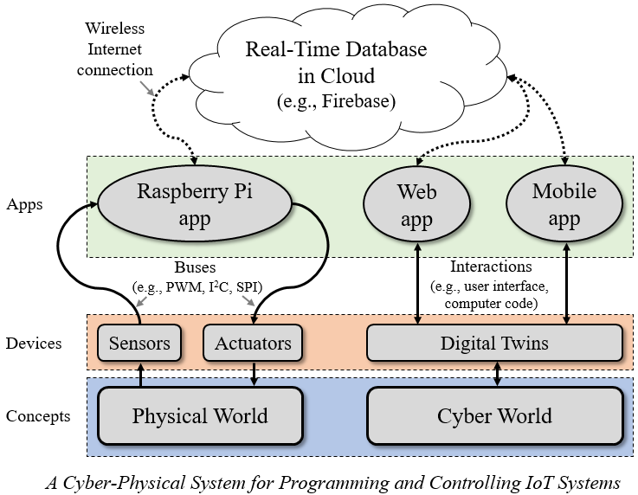
EVOLUTION OF CPS
9 /39
Digital Factory
Relationship between the physical and cyber systems
http://www.lexer.co.jp/en/product/iot
https://medium.com/@charlesxie/building-a-cyber-physical-system-to-simplify-iot-app-development-f3579b7916dc

Slide 10
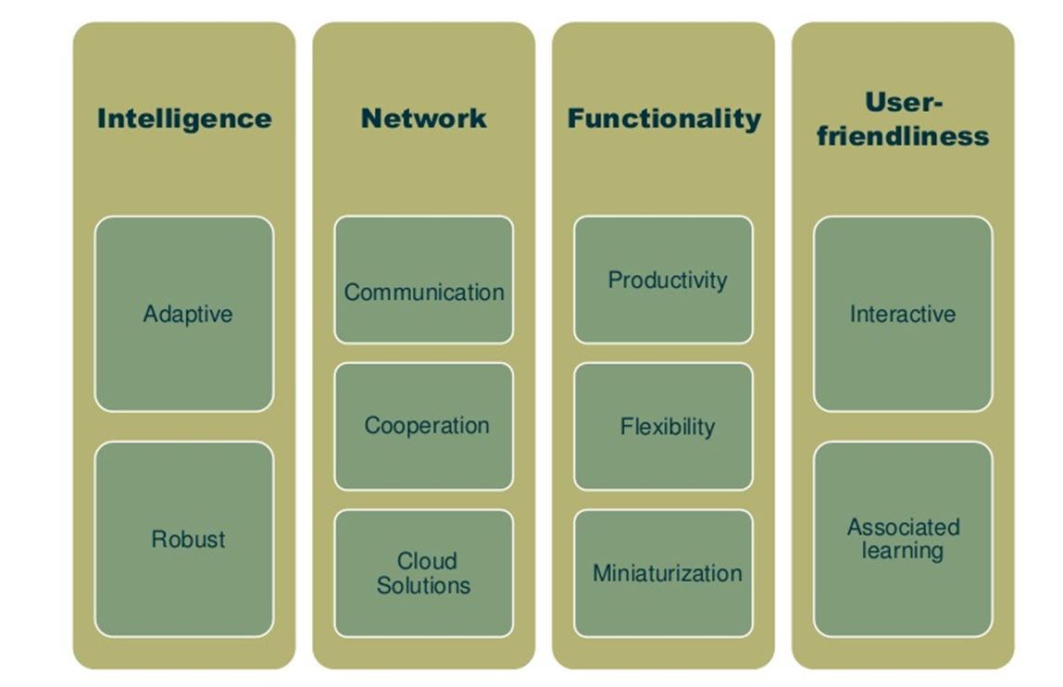
EVOLUTION OF CPS
10 /39
Digital Factory
Characteristics of CPSs

Slide 11
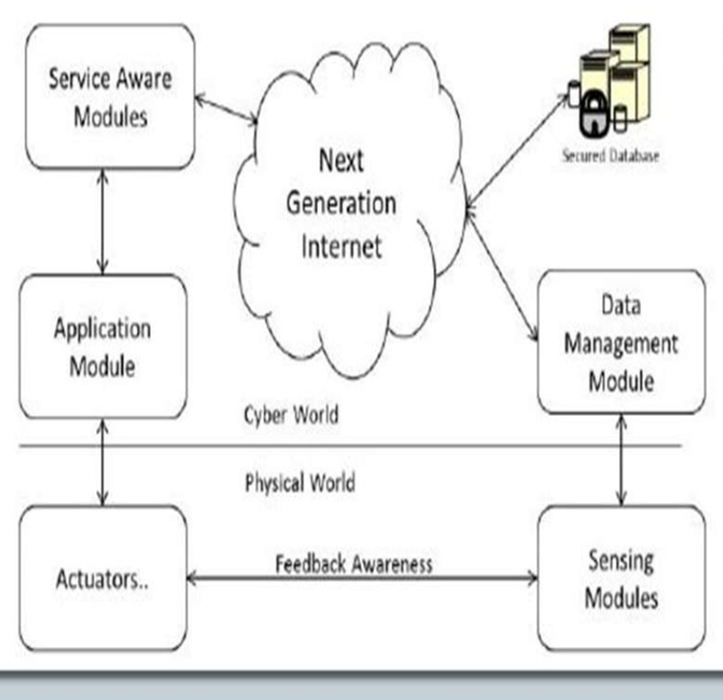
EVOLUTION OF CPS
11 /39
Digital Factory
MODULES IN CPS
Sensing Module
Data collection from physical world through sensors
Data Management Module(DMM)
Consists of the computational devices and storage media
Next Generation Internet
Enabling applications to select the path, or paths that their packets take between the source and destination
Service Aware Modules (SAM)
Sensed data is being recognized and sent to the services available
Application Module (AM)
Service are deployed and interact with NGI
Info is saved on database for QoS support.(NoSQL)
Sensors and Actuators
Actuator receives the commands from the Application Module, and executes

Slide 12
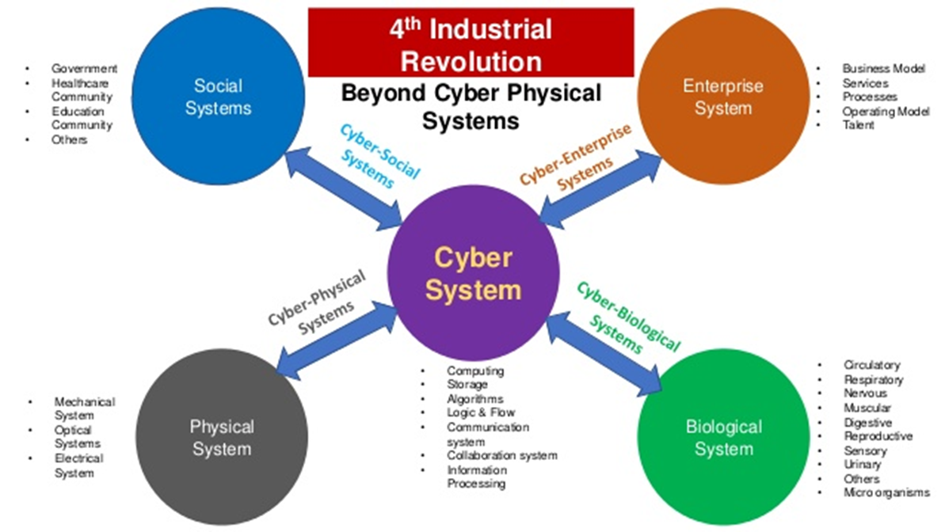
EVOLUTION OF CPS
12 /39
Digital Factory
https://pt.slideshare.net/vsr0001/4th-industrial-revolution-is-beyond-cyber-physical-systems

Slide 13
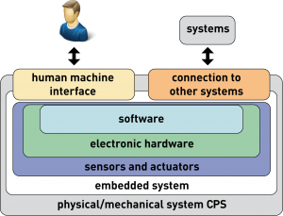
CPS Difference from software and embedded systems
13 /39
Digital Factory
Where CPS Differs from General-Purpose Software Systems?
Software Systems Problem:
Software systems are sets of interacting sequences of state transformations with the end objective of transforming data
The CPS problem:
CPS has the end objective of orchestrating physical processes. Timeliness, safety, reliability, security, privacy, and adaptability all take on a different character
http://addi-data.com/cps-cyber-physical-systems/

Slide 14
CPS Difference from software and embedded systems
14 /39
Digital Factory
Where CPS Differs from Embedded Systems
The embedded systems problem:
Embedded software is software on small computers. The technical problem is one of optimization (coping with limited resources)
The CPS problem:
Computation and networking integrated with physical processes. The technical problem is managing time and concurrency in networked computational systems

Slide 15
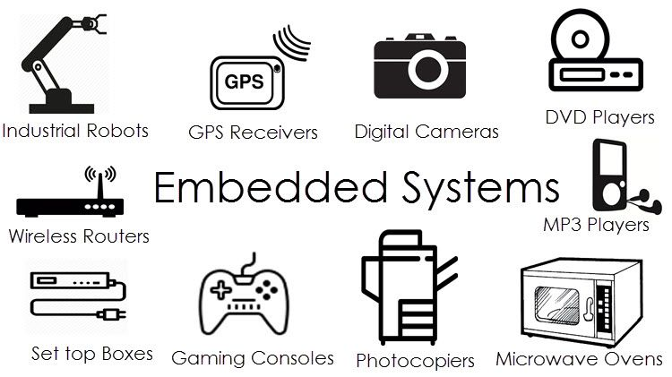
CPS Difference from software and embedded systems
15 /39
Digital Factory
Traditional Embedded Systems vs. Cyber physical System
Typically Stand-alone
Networked Embedded Systems
Information processing systems embedded into enclosing products
Integrations of Information Processing and Physical Process
Traditional Embedded Systems
Cyber physical System
Focus on constrained devices (CPU, Memory)
Intelligence-on-the-cloud: not constrained
Focus on Real time Response and Reliability (Instruct-Act)
Focus on Sensing based Analytics and Business Intelligence
From Embedded
………
Towards CPS

Slide 16
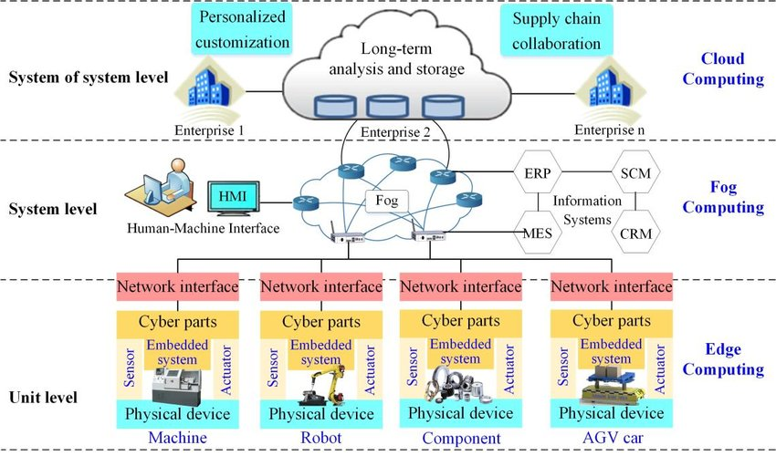
Heterogeneity and Modeling
16 /39
Digital Factory
https://www.researchgate.net/figure/Modeling-of-various-levels-CPS-and-DT-in-manufacturing-based-on-edge-computing-fog_fig1_327856531

Slide 17
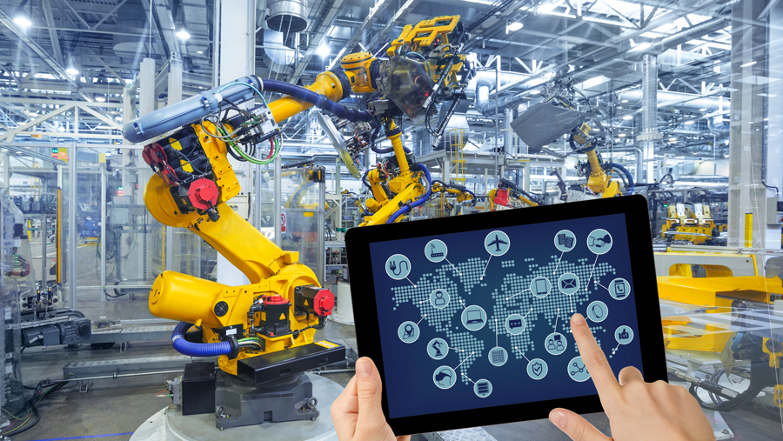
Long-Term Goal OF CPS
17 /54
Digital Factory
Transform how we interact with the physical world just like the internet transformed how we interact with one another.
Convergence of embedded systems, control theory, hybrid systems, microcontrollers, sensor, actuators, wireless networks, wide area networks, distributed systems, operating systems, advances in structures
Building CPSs that integrate computational and physical objects requires new systems science foundations.
Fusion of physical and computational sciences

Slide 18
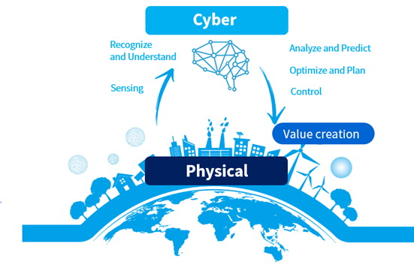
Upgradation Interaction & Coordination
18 /54
Digital Factory
Changes in Cyber
Rich time models instead of sequencing
Behavioral invariants instead of end results
Functionality through interactions of ongoing behaviors instead of sequence of actions
Component architectures instead of procedural abstraction
Changes in Physical
Concurrency models with partially ordered instead of linearly ordered event sets
Precise interaction and coordination protocols
Hugely increased system size with controllable, stable behavior
Dynamic system architectures (nature and extent of interaction can be modified)
Adaptive, autonomic behavior
Self-descriptive, self monitoring system architecture for safety guarantees.

Slide 19
Scientific and technical challenges
19 /39
Digital Factory
Integrating complex, heterogeneous large-scale systems
Interaction between humans and systems
Dealing with uncertainty
System design
Measuring and verifying system performance

Slide 20
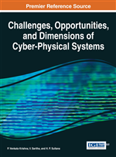
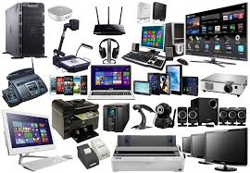
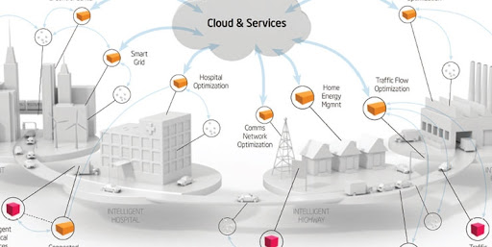
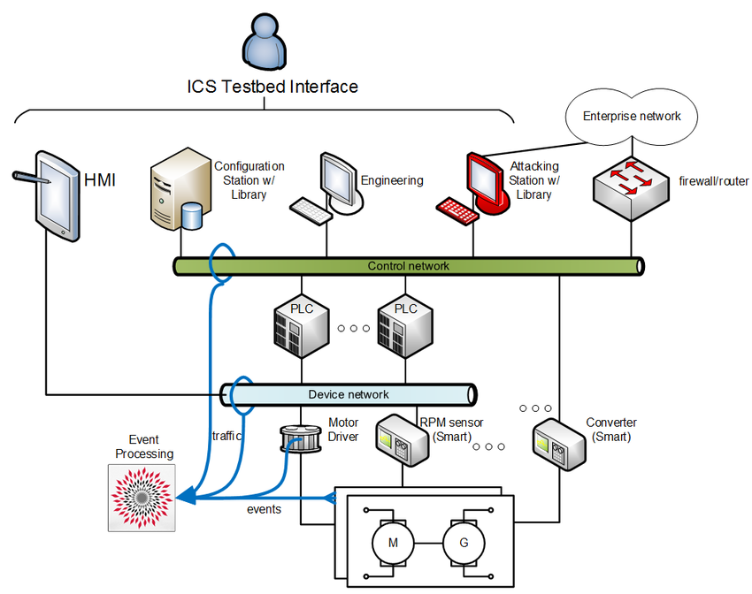
Design process of CPS
20 /39
Digital Factory
Phase 1
• Application knowledge
Phase 2
• Specification
• Hardware/Software components
Phase 3
• Design repository
• Application mapping
Phase 4
• Design
• Test

Slide 21
Scientific and technical challenges
21 /39
Digital Factory
Compositionality: system-level properties can be computed from local properties of components
Composability: component properties are not changing as a result of interactions with other components.
Heterogeneity CPS are heterogeneous in components and design requirements.
CPS products make design flows product specific which is bad for design automation.
COST: The cost of certification of complex systems is high.
Security: issues. One side can be attacked through the other side.

Slide 22
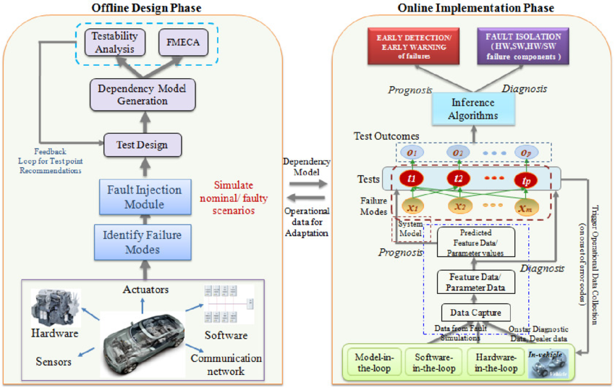
Challenges for CPS software design
22 /39
Digital Factory
• Dynamic environments
• Capture the required behavior
• Validate specifications
• Efficient translation of specifications into implementations
• How can we check that we meet real-time constraints?
• How do we validate embedded real-time software? – large volumes of data – testing may be safety-critical

Slide 23
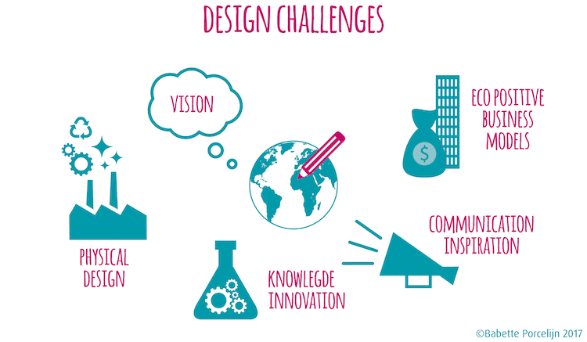
Expectations and design challenges of CPS
23 /39
Digital Factory
• Dependability
• Efficiency
• Meeting real-time requirements
• Hardware properties, physical environment

Slide 24
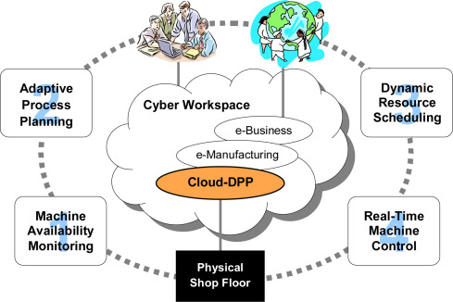
Institutional, societal, and other challenges
24 /39
Digital Factory
Trust, security, and privacy
Effective models of governance
Creation of CPS business models
Understanding the value of CPS

Slide 25
Application
25 /39
Digital Factory
Applications of CPS
https://www.researchgate.net/figure/Application-Scenarios-of-cyber-physical-systems-describing-the-information-flow-and_fig2_329466954

Slide 26
Security and Privacy Issues in Cyber-Physical Systems
26 /39
Digital Factory
Differences between corporate IT security and CPS security
Software patching and frequent updates, are not well suited for control systems
While availability is a well studied problem in information security, real-time availability provides a stricter operational environment than most traditional IT systems
Large industrial control systems also have a large amount of legacy systems (most of the efforts done for legacy systems should be considered as short-term solutions; underlying technology must satisfy some minimum performance)
Network dynamic
https://www.youtube.com/watch?v=_6IZ5yCYwx8

Slide 27
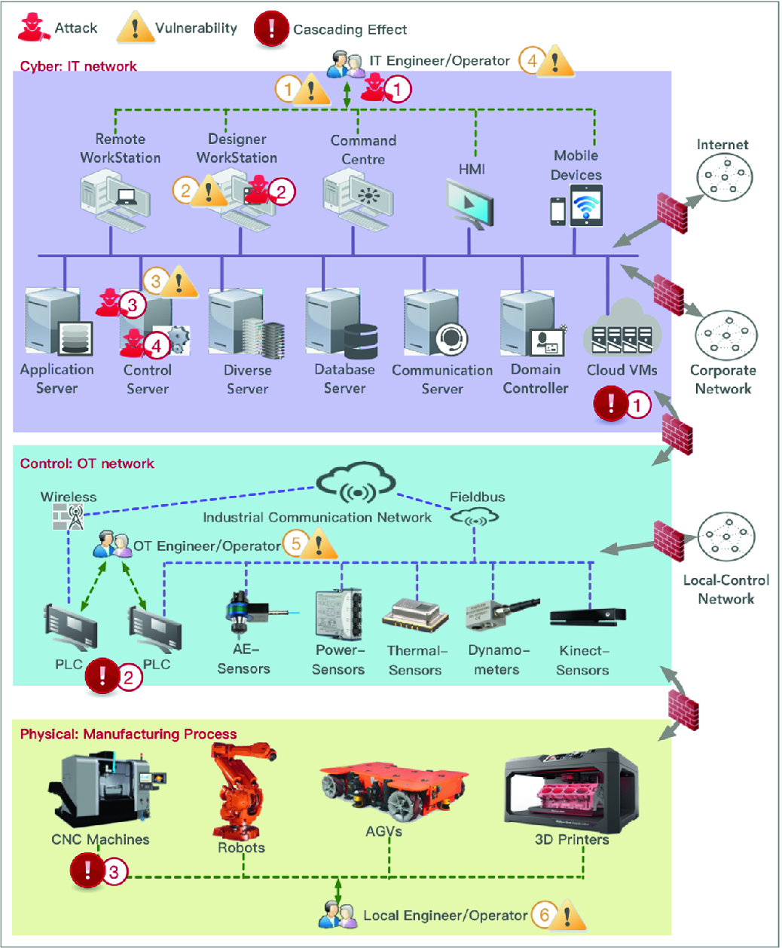
Security and Privacy Issues in Cyber-Physical Systems
27 /39
Digital Factory
New security problem in CPS/Control systems
Authentication, access control, message integrity, separation of privilege, etc. can all help
Traditionally focused on information (security)
How attacks affect the estimation and control algorithms?
Ultimately, how attacks affect the physical world
Intrusion Detection Systems (IDSs) have not considered algorithms for detecting deception attacks launched by compromised sensor nodes against estimation and control algorithms
Dynamics of physical systems bring more challenges and set of problems
Information awareness to operators of control systems

Slide 28
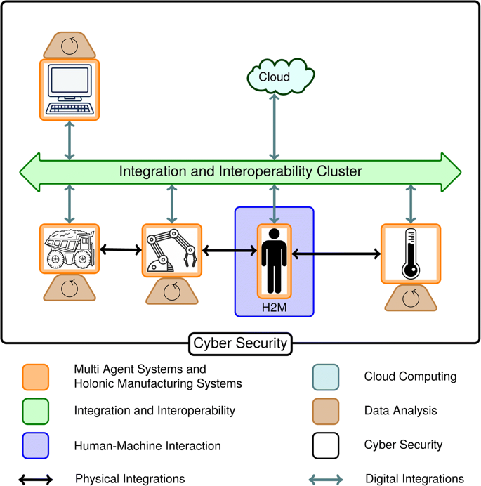
Security and Privacy Issues in Cyber-Physical Systems
28/39
Digital Factory
Countermeasures
Most of the effort for protecting control systems has focused on reliability (the protection of the system against random faults)
urgent growing concern for protecting control
systems against malicious cyber attacks
Dimensions
Prevention
Detection and recovery
Resilience
Deterrence

Slide 29
Security and Privacy Issues in Cyber-Physical Systems
29/39
Digital Factory
Prevention
cybersecurity standards
North American Electric Corporation (NERC) cybersecurity standards for electric systems.
- NERC is authorized to enforce compliance to these standards, and it is expected that all electric utilities are fully compliant with these standards
NIST
- SP 800-53* the guideline for security best practices which federal agencies should meet
- Guide to Industrial Control System (ICS) Security
ISA (International Society of Automation)
- ISA SP 99: a security standard to be used in manufacturing and general industrial controls
ETSI
SCADA - Supervisory Control And Data Acquisition
Standardization efforts with respect to access control and key management in wireless sensor networks
* NIST Special Publication 800-53, "Security and Privacy Controls for Federal Information Systems and Organizations,"

Slide 30
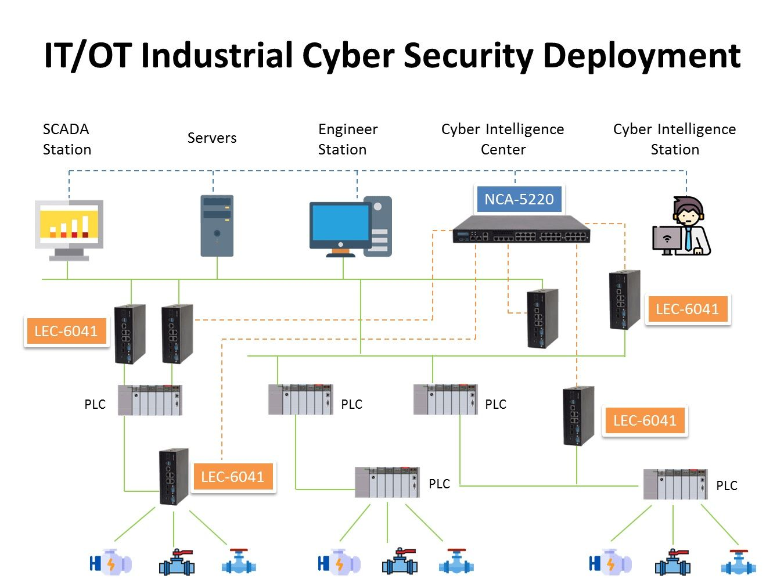
Security and Privacy Issues in Cyber-Physical Systems
30/39
Digital Factory
Example of Prevention with SCADA

Slide 31
Security and Privacy Issues in Cyber-Physical Systems
31/39
Digital Factory
Detection and recovery
Utilizing our knowledge of the physical systems, control systems can provide a paradigm shift for intrusion detection e.g. by monitoring the physical system for anomalies we may be able to detect attacks that are undetectable from the IT side, e.g. against resonance attack
Identify deception attacks launched by compromised controllers and/or sensors
Implement a model-based detection scheme, e.g. as game between the detector and the attacker
Utilizing ideas from control theory such as reconfiguration or fault-detection and isolation, to design autonomous and real-time detection and response algorithms for safety-critical applications that require real-time responses
https://www.slideshare.net/exigent/how-to-implement-nist-cybersecurity-standards-in-my-organization-125956627

Slide 32
Security and Privacy Issues in Cyber-Physical Systems
32/39
Digital Factory
Example of NIST Standard
https://infocus.delltechnologies.com/michael_dulavitz/strengthen-security-of-your-data-center-with-the-nist-cybersecurity-framework/

Slide 33
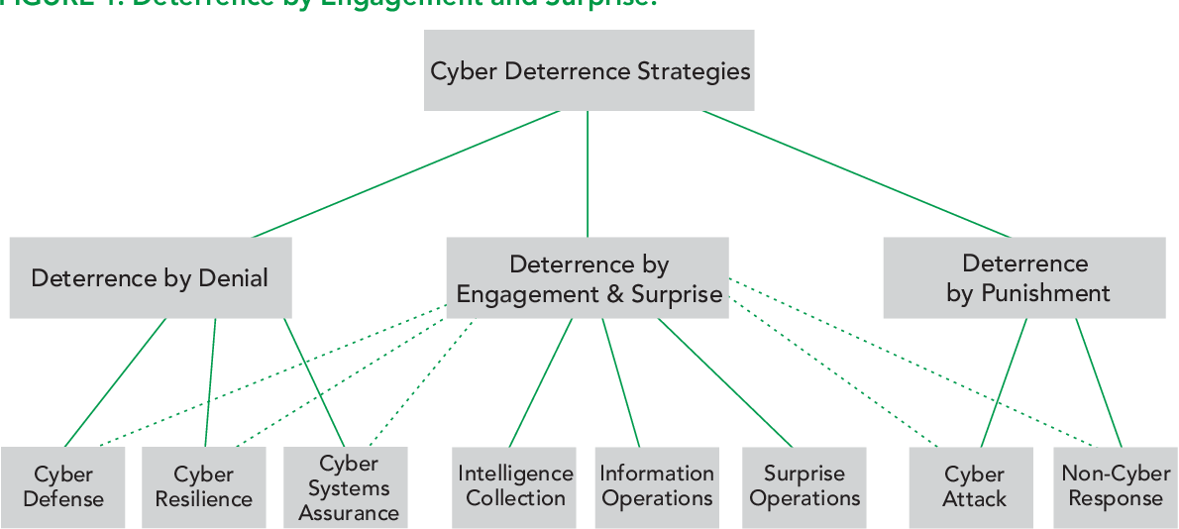
Security and Privacy Issues in Cyber-Physical Systems
33/39
Digital Factory
Resilience and deterrence
Useful principles
Redundancy as a way to prevent a single-point of failure
Diversity as a way to prevent that a single attack vector can compromise all the replicas (the added redundancy)
Principle of least-privilege, and the separation of privilege (also known as separation of duty) principle
In CPS, physical and analytical redundancies should be combined with security principles (e.g., diversity and separation of duty) to adapt or reschedule its operation during attacks
Design novel robust control and estimation algorithms that consider more realistic attack models from a security point-of-view, e.g. Game Theory
Deterrence

Slide 34
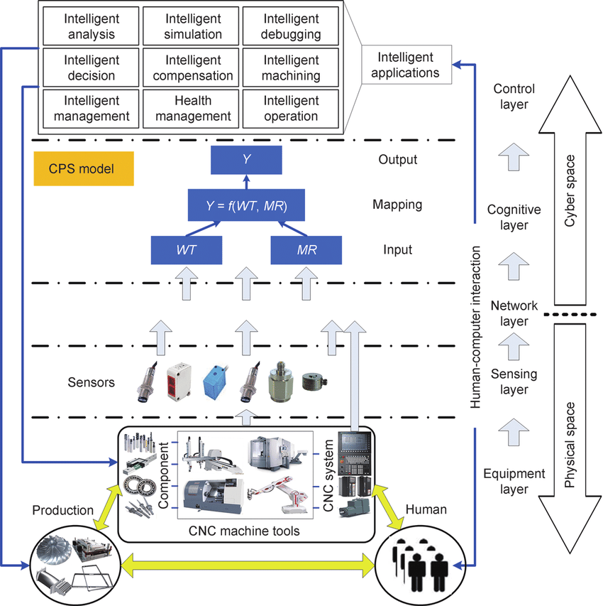
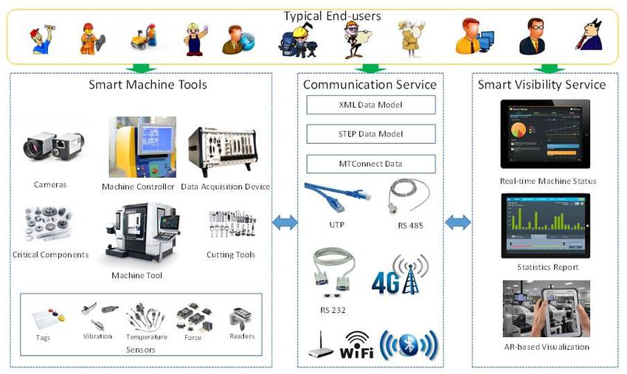
34 /39
Activities (Example)
Digital Factory
The-CPS-architecture-of-CNC-machine-tools-with-a-CPS-model
https://www.researchgate.net/figure/CPS-enabled-Smart-Machine-Tools-After-the-smart-design-CPS-enabled-smart-machine-tools_fig3_322673524
https://www.researchgate.net/figure/The-CPS-architecture-of-CNC-machine-tools-with-a-CPS-model_fig1_283117000

Slide 35
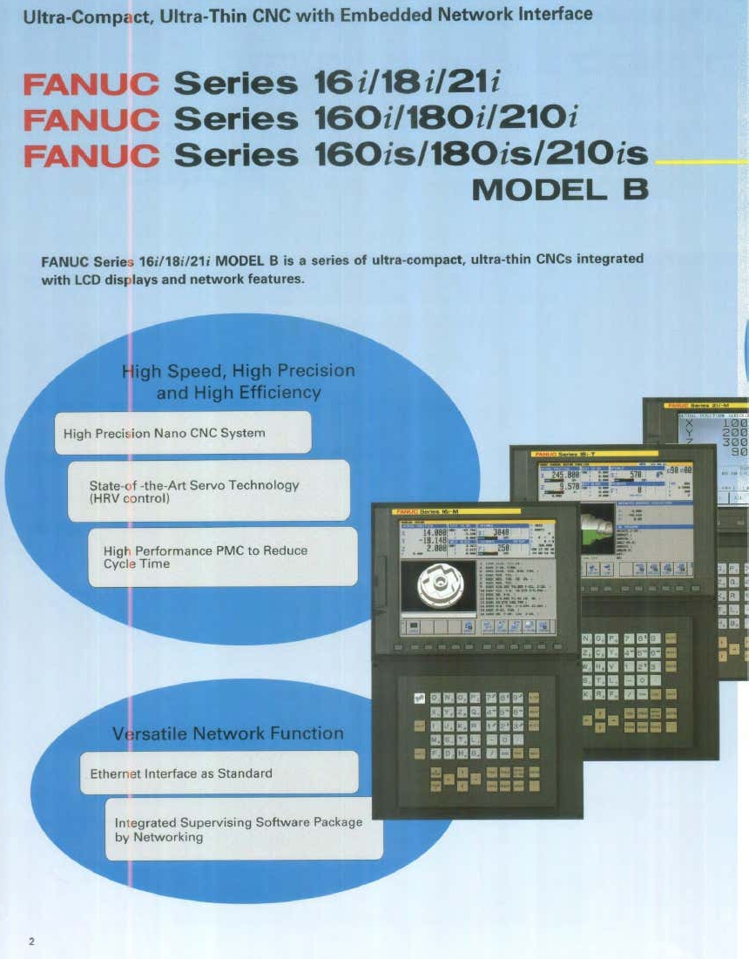
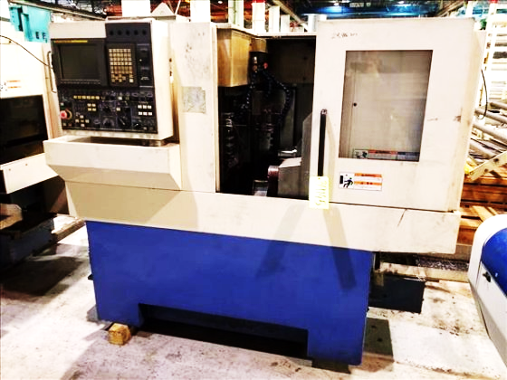
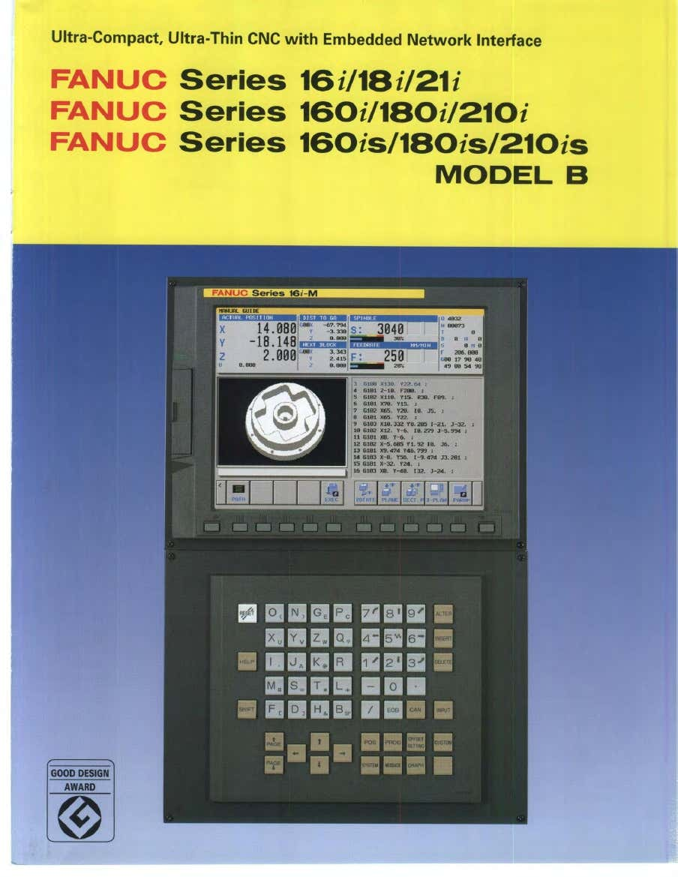
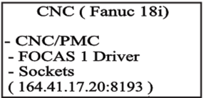
Activities (Lab sheet)
35 /39
Digital Factory
Design and development of a system for CNC turning to be in the form of Cyber-Physical Production Systems by writing architecture, data flow diagram and some available services. Streamlining process in the production line of CNC turning. Use data below:

Slide 36
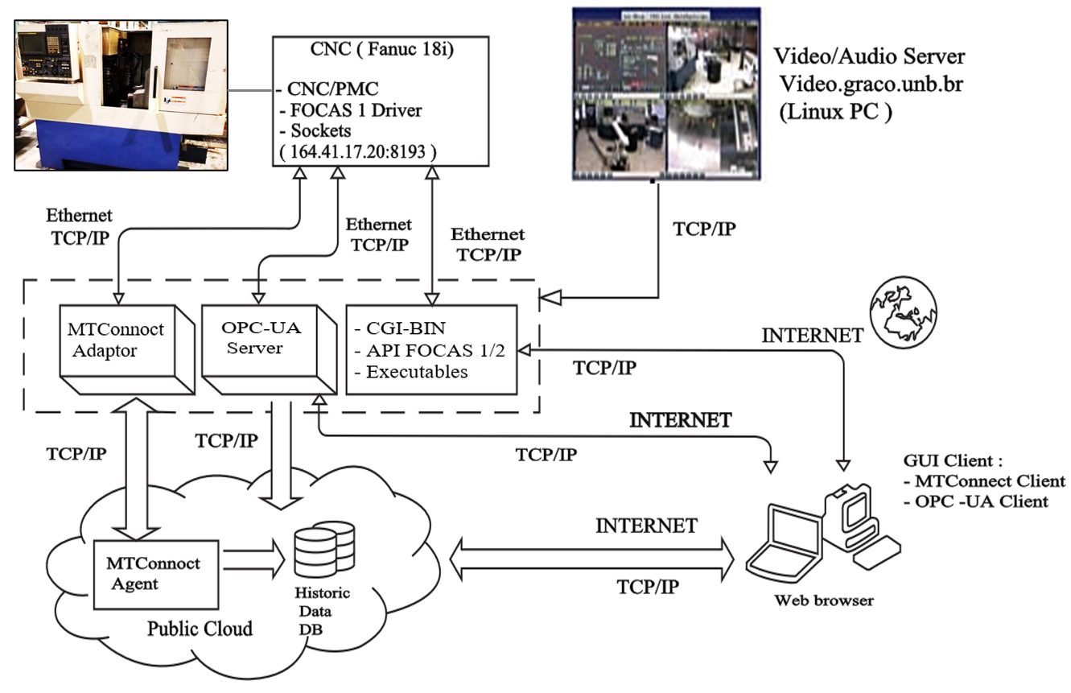
Activities (Lab Sheet_ answer)
36 /39
Digital Factory
Cyber-Physical Production Systems: architecture, data flow and some available services.
Oliveira, L.E.S., A lvares, A.J.(2016)

Slide 37
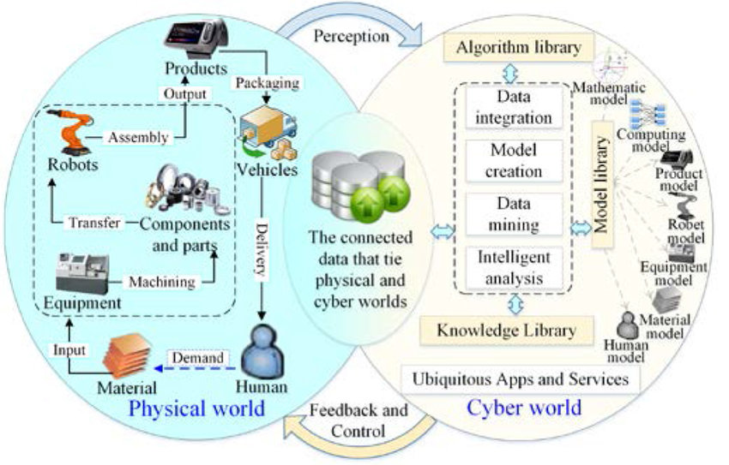
Summary
37 /39
Digital Factory
Cyber-physical systems are everywhere, from semi-autonomous vehicles to wearable devices. These types of systems blend human and compute power, and integrating mechanical systems with human physical interaction giving both a form of "super powers". Opportunities to specialize in cyber-physical systems are growing as quickly as the technology itself, from large corporations to individual makers ...
CPS is the way to streamlining process in a production line of an existing traditional factory using a data flow diagram.
https://www.researchgate.net/figure/Manufacturing-cyber-physical-integration-and-fusion-supported-by-CPS-in-SoSM_fig6_318694164

Slide 38
Learning Outcome
38 /39
Digital Factory
Formulate a data model representing data streamlining in a production line of an existing traditional factory using a data flow diagram

Slide 39
39/39
Thank you

