Slide 1
Digital Factory
Factory digitalization
LabSheet
Professor Dr. Athakorn Kengpol

Slide 2
Lab Sheet: Gear factory
This lab suppose you are production engineer in gear factory
Blank parts (raw material) arrive by pallet at Receive location. The Work piece arrives at pallet 5 minutes per 1 piece.
From the Receive location they are sent to NC Lathe1 or NC Lather2, where they undergo a lathe operation to be Cog that takes an average of 3 minutes.
The cogs go to the degrease location, where they are batched of two pieces then removed exceed grease by degreasing machine that take 5 minutes.
After degreasing, each cog goes to the inspection location. For the inspection process take a time that is uniformly distributed with a minimum 4minutes.
The last process is assembly the passing cogs with a bearing that takes a minimum 2 minutes uniformly distributed.

Slide 3
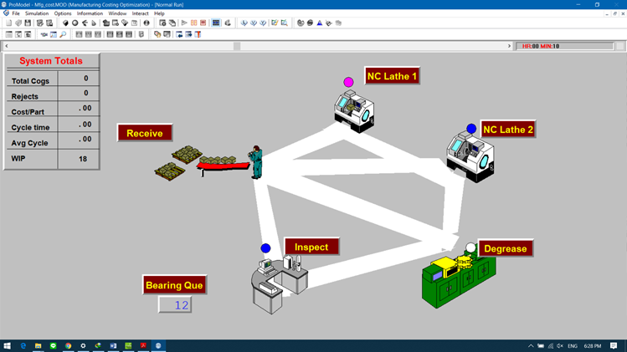
Lab Sheet: Gear factory
The processes are showed in Figure . There is only one operator in the department to operate all processes. You need to improve this process with the goal to reduce cycle time and increase production rate. You are interesting in the number of operator. Unfortunately, you cannot experiment with the physical system. In this situation, you may think about the factory digitalization.
Layout of gear factory

Slide 4
Lab Sheet: Gear factory
Assignment
Created simulation model of the gear factory by used Tecnomatix. Simulate the system for 10 hours of scenario then track cycle time and production rate. If the goal of improvement is increase production rate and productivity line balancing, how to do you improve the production line?
Objective
This lab reinforces the following skill:
Concept of Factory digitalization and Simulation.
Manipulate parameters of the model to achieve the goal.

