Slide 1
Digital Factory
Simulation of a production line
Module II: Digital Factory Modeling: How to formulate a virtual world
Professor Dr. Athakorn Kengpol, KMUTNB

Slide 2
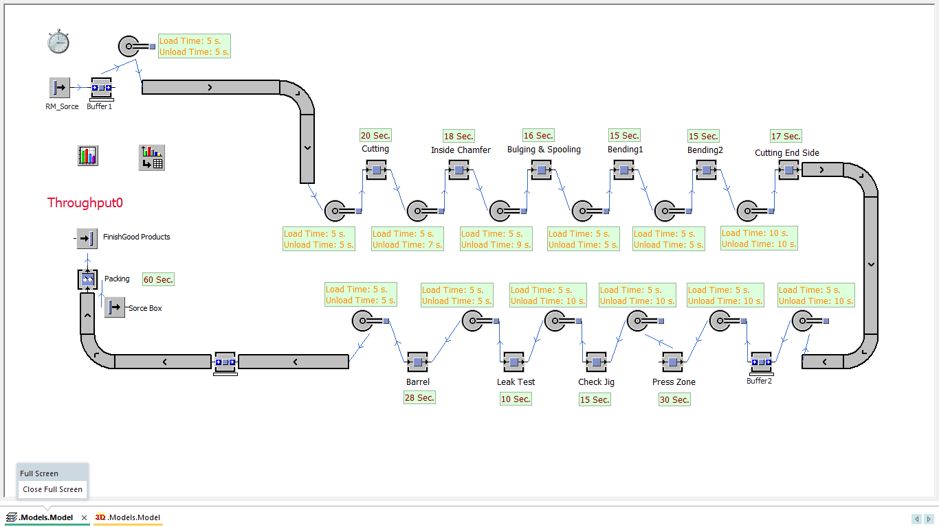
Activity (Lab Sheet)
Determine the daily and weekly minimum production rate from simulation based on lab sheet condition.
Explain and compare the results from simulation and actual production rate of factory (1,200 pcs./day).
Explain the resource statistic in each station and improvement process for increase productivity or reduce waiting time and bottleneck problem.
40/40

Slide 3
40/40

