Slide 1
Course 6: Digital Factory
Module I: Introduction to digital factory: Road to digital transformation (hybrid online/offline mode)

Slide 2
Activity 2: Discussion on readiness of industry
Instructor shows videos from different production lines and encourage students to discuss what level of industrial advancement displayed in the footage.
Furniture Factory 1
Furniture Factory 2
Furniture Factory 3
Furniture Factory 4
Tire Factory
https://www.ssim.ac.in/blog/how-to-prepare-for-group-discussion/
2/11

Slide 3
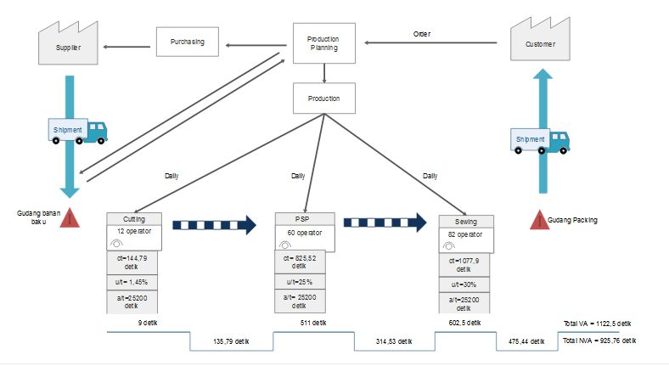
Activity 2: use Lean Principles to simplify the value stream
VALUE STREAM
Example of a Value Stream Map (current state mapping)
A golf glove production line
https://www.edrawmax.com/value-stream-mapping/
https://www.edrawsoft.com/what-is-value-stream-mapping.html
3/11

Slide 4
Activity 2: use Lean Principles to simplify the value stream
VALUE STREAM
Draw a value stream map of over-counter money withdrawal at a bank.
https://www.edrawmax.com/value-stream-mapping/
https://www.edrawsoft.com/what-is-value-stream-mapping.html
4/11

Slide 5
Activity 4: use Lean Principles to simplify the value stream
Practice “Lean”
Choose a process as a case study and follow five principles
of “Lean”.
5/11

Slide 6
Activity 5: Developing a lean digital capability
From the case study, assess the digitalization potential
Which physical process steps can be automated
by mature and proven technologies?
2. Which remaining non-physical (information) process
steps can be radically digitalized?
6/11

Slide 7
Activity 2: Self Study (Type of System Integration)
After reading the article: “Industry 4.0 and lean management: a propose integration model and research proposition ”(M. Sony, 2018)
Discussion: Define system integration and how is it typified?
7/11

Slide 8
Activity 4: Self Study (Integration Analysis)
After reading the article: “Industry 4.0 and lean management: a proposed integration model and research propositions”(M. Sony, 2018)
Discussion:
Where is the customer in the system integration?
How can the integrated system produce a customized product?
What are being shared between the machines, production units, or production facilities when they are integrated?
Once digitally transformed, can you identify potential risks in each subsystem?
8/11

Slide 9
Activity 4: Self Study (Integration Analysis)
Discussion:
Where is the customer in the system integration?
Customer could lie at the beginning of the enterprise’s horizontal chain to pull resources and trigger activities in it.
How can the integrated system produce a customized product?
Once a customer places his order, the data are passed down the stream and all the units must react in response to the order. System agility and flexibility are significant.
What are being shared between the machines, production units, or production facilities when they are integrated?
Beside physical WIPs, data streaming along the chain are what the units must be sharing to create a synchronous working environment within a digital factory.
Once digitally transformed, can you identify potential risks in each subsystem?
Cyber security would be the most concerned. However, not only an efficient IT system and operators to look over it, the enterprise needs also highly technical operators to keep the production running and maintain its productivity.
9/11

Slide 10
Activity 4: Self Study (Integration Analysis)
After reading the article: “Industry 4.0: Survey from a System Integration Perspective” Pg. 17 (M. Sanchez et.al, 2020)
Discussion:
What could be “Integration Challenges in Industry 4.0”?
Figure 5, Pg. 17
10/11

Slide 11
Thank you

